Slide 1


WELCOME TO

Slide 2

To insert your logo:
Delete the “company logo here” text box
Select logo file using “Insert Picture” feature under “Insert” in your toolbar
Resize accordingly and center your image in the white circle
Delete this instruction box
company logo here
How to use [company name]
global medical and security
assistance program.

Slide 3
Who is International SOS?
International SOS is the world’s leading medical
and security services company

Slide 4


27 Assistance Centers
Worldwide
CONVENIENCE: Local medical and security expertise provided globally in any language, anytime 24/7/365.
79,000+ accredited
providers
DELIVERY: A vast network of accredited healthcare, aviation and security providers ensuring you receive high standards of care in the air and on the ground.
5,200+ medical professionals
EXPERTISE: Immediate access to professionals with extensive experience in all areas of medicine, coupled with a thorough knowledge of the local environment and healthcare system.
45+ clinics worldwide
QUALITY: Our set of global protocols and procedures ensures that we adhere to international standards of medicine—even in developing countries (subject to local clinic terms and conditions).

Slide 5



International SOS provides
Reassurance
  One call will immediately start resolution to your situation – whether an emergency
  or routine advice.
Quality Medical Care
  Confidential medical advice from experienced, internationally-
  trained doctors.
  Providers are credentialed by
  our medical staff to ensure
  quality treatment.
Peace of Mind
  An experienced, culturally knowledgeable partner who operates in nearly 90 countries and locations is there to help you.
Convenient Access
  24/7 coverage, 365 days per year offering expert advice in more than 90 languages and dialects.
  Comprehensive, up-to-date members only website to keep
  you informed.

Slide 6

Stay healthy, safe and secure
Contact us when you are outside your home country if you have:
  Medical Question or Concern
  Medical Emergency
  Safety Concern
  Security Emergency
  Travel Assistance
When you need help,
International SOS is there for you.
Is it safe to venture outside my hotel for coffee?
I’m ill, should I see a doctor? Where should I go?”
I’ve had
a heart attack!
I’ve been
pick-pocketed!
There are rioters outside my hotel!

Slide 7
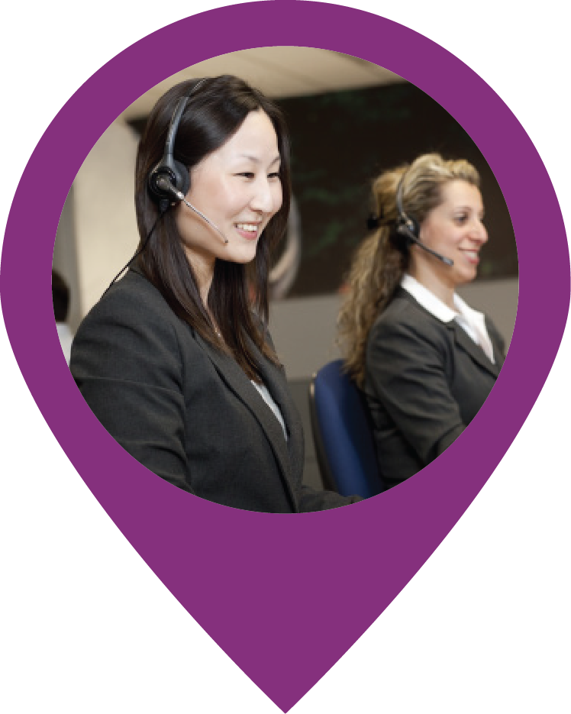
How to reach International SOS
  KEEP your membership card with you at all times.
  INFORM friends and family you are an International SOS member so they can get in touch should they have concerns for your welfare while away.
  DOWNLOAD our free app on your smartphone from
  http://app.internationalsos.com for one-click routine or emergency assistance worldwide – an essential tool for any employee on the move.
  LOGIN to www.internationalsos.com with your membership number and familiarize yourself with the full benefits of your specific membership.
  CALL us 24/7/365 with any health, travel security
  or personal safety concerns, for routine advice
  or emergency assistance.

Slide 8
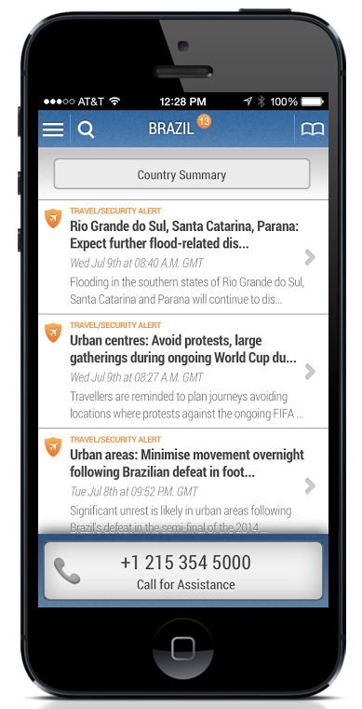
International SOS Assistance App
Call us anytime, anywhere at any of our assistance centers around the world using the Assistance App
  In time of need, you can quick dial for immediate help from
  an International SOS assistance center, whether it’s for an emergency or just advice.
  Gives you peace of mind and the ongoing confidence to travel
  or live anywhere in the world knowing this safety net is always available 24/7/365 simply by pressing a button.
  Easy access to timely medical and security alerts for your location,
  so you are kept aware of changing situations and can quickly adjust plans as needed.
  Supplements your International SOS membership card, ensuring
  you always have your membership card.

Slide 9

Prepare yourself before traveling
Before you leave, prepare yourself:
  Access accurate, real-time information on www.internationalsos.com. View country guides,
  online medical and security reports, and sign up
  for health and safety e-mail alerts.
  Call an assistance center for pre-travel information
  (i.e. vaccination, required medication and travel
  security concerns).
  Download the Assistance App.
Remember:
An ounce of prevention is worth a pound of cure.

Slide 10
Stay healthy, safe, and secure while abroad
Contact us when you:
  Require health, safety and security advice
  Need to speak with an experienced internationally trained specialist
  Need a specialist credentialed by our staff
  Require supplies of medication or equipment
  Need travel advice on loss of travel documents or legal assistance

Slide 11

Helping you in an emergency
If the “unthinkable” happens, call us to:
  Arrange transportation
  Monitor your condition and advise
  Evacuate you to a center of excellence if local facilities are inadequate or to a safe meeting point when necessary
  Contact your family
  Coordinate repatriation of mortal remains

