Slide 1
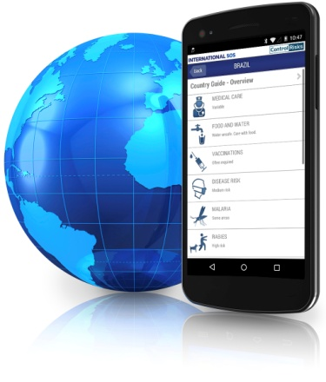
Assistance App
Client Name
Date

Slide 2
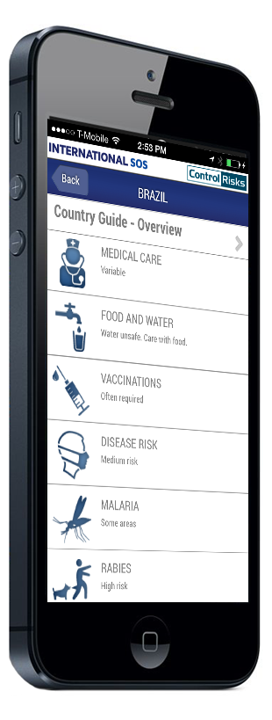
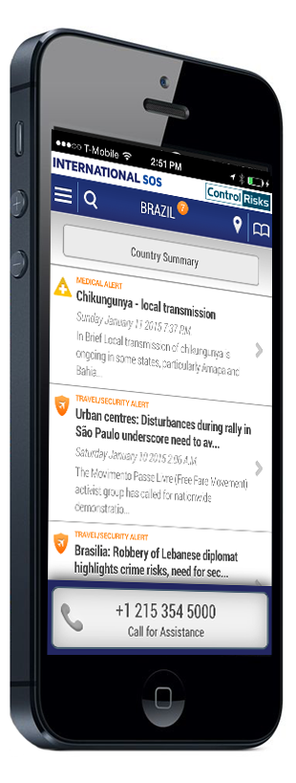
Agenda
What is the Assistance App?
Benefits to your Organization
How the App Works
Implementation & Support
Promoting the Assistance App

Slide 3
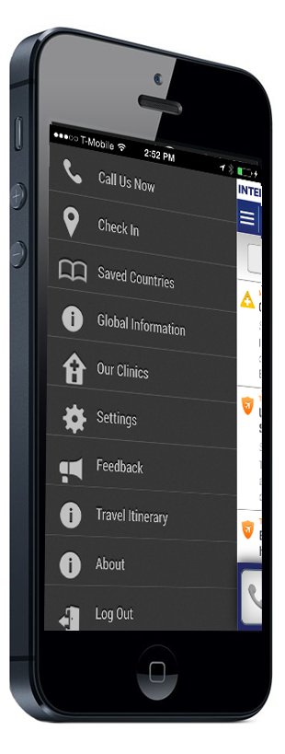
What is the Assistance App?
An essential tool for any employee on the move so they can make the most of their International SOS membership. With the Assistance App, travelers and expatriates have a world of capability in their hand - it is the only medical and travel security app integrated into a global assistance infrastructure.
Having mobile access to travel security and health information, employees can make informed, thoughtful decisions on critical health and safety issues that may affect their wellbeing.

Slide 4
Benefits to your Organization
Promote the value of International SOS membership and demonstrate that you play a key role in keeping them healthy, safe and secure while they travel or live abroad
Give your travelers and expatriates seamless integration with our Assistance Center network and assistance services to shorten response times and accelerate each member’s access to immediate help and assistance whenever they need it
Empower your travelers and expatriates to make thoughtful decisions so they look after their safety and wellbeing while on the move
Enhance compliance with your travel security policies
Help your travelers and expatriates understand how to use their membership

Slide 5
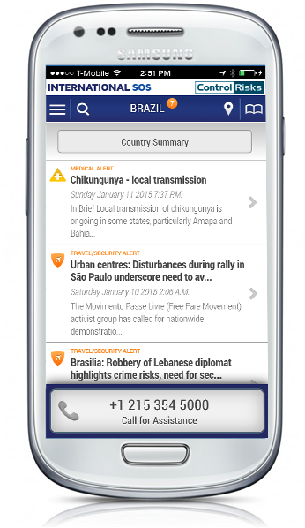
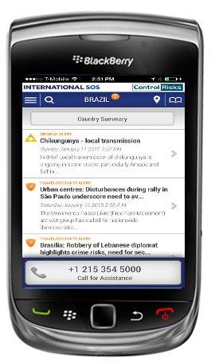
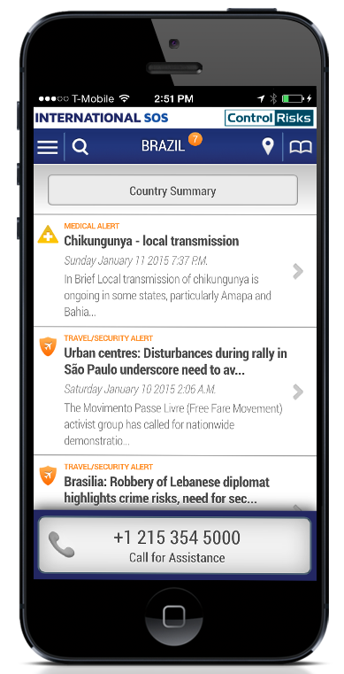
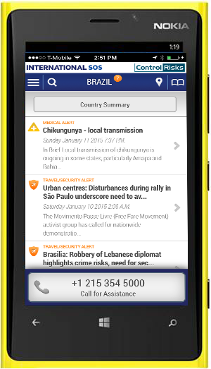
Assistance App Availability
Android OS 2.3 and higher
BlackBerry
OS 6.0 – 7.0
iPhone
iOS 4 and higher
Windows
OS 8.0 and higher

Slide 6
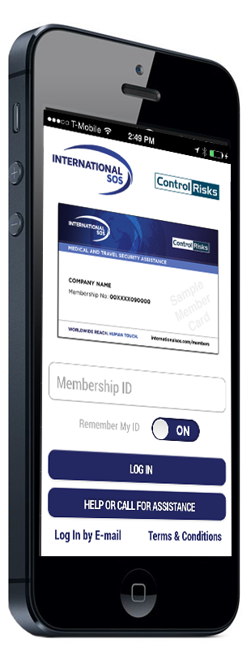
JUST CALL VIDEO
Play the “Just Call” video for examples on why to
call our assistance centers. The video is available in
multiple different languages.
LOGIN
After you download and launch the App you will
need to enter your International SOS
Membership Number to login.
Select “ON” next to Remember so you don’t have
to type in the Membership number each time you
login.
Select “Help or Call for Assistance” if you have
forgotten your Membership Number or if you need
to quickly call the Assistance Center.

Slide 7
ACCESS THE MENU
Click here to access additional features including settings, push notifications, and your favorites.
CHECK-IN
Quick access to ‘check-in’ to your location. (onlyavailable to TravelTracker customers)
ALERTS
Instant access to the latest medical and security alerts for your current location from International SOS and Control Risks.
CALL FOR ASSISTANCE
If you need routine advice or assistance during an emergency click on the ‘Call for Assistance’ button. The call will be directed to the nearest International SOS assistance center.

Slide 8
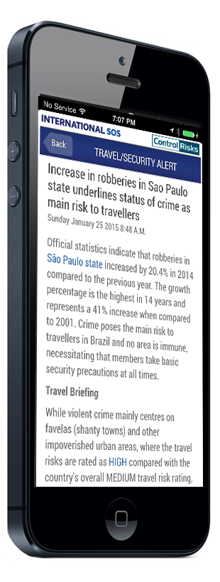
ALERTS
Instant access to the latest medical and security
alerts for your current location from International SOS and Control Risks.

Slide 9
COUNTRY GUIDE OVERVIEW
Provides quick access to global medical and travel security information. Icons make it easy to find the topics you need to prepare for your next trip abroad.

Slide 10
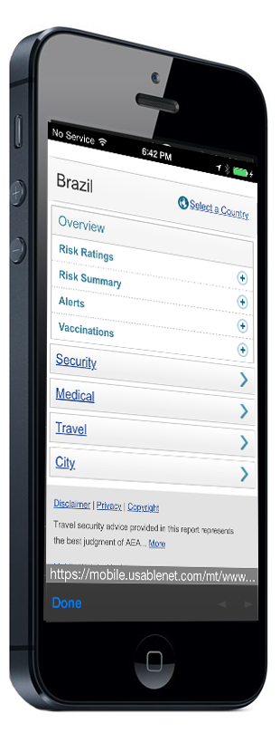
COUNTRY GUIDES
Mobile-friendly format for easy viewing on the go.
Medical information, including vaccinations,
infectious diseases, medication, food and water
safety, and cultural tips.
Travel and security information, including risk
ratings on 220 countries and 330 cities

Slide 11
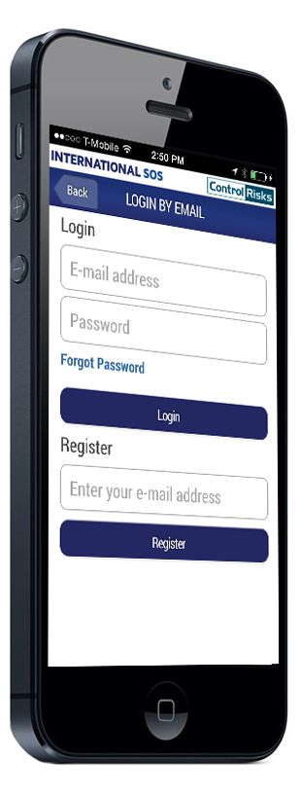
LOGIN BY EMAIL
Insert Info

Slide 12
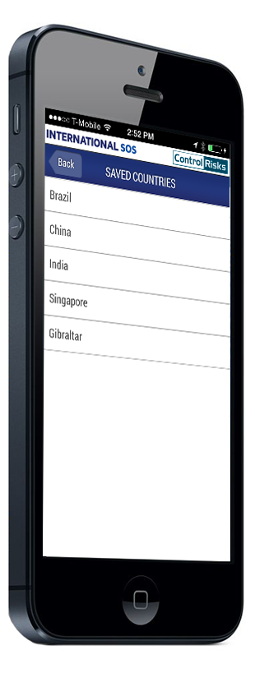
SAVED COUNTRIES
Insert info

Slide 13
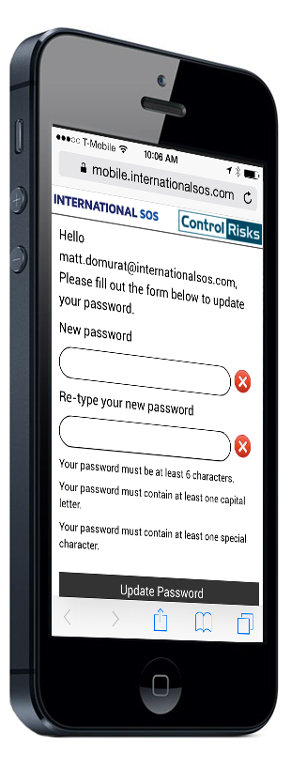
UPDATE PASSWORD
Insert Info

Slide 14
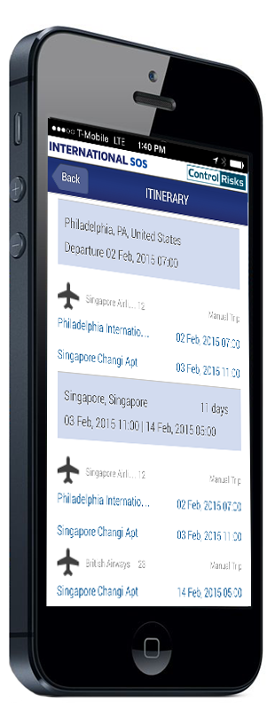
ITINERARY
Insert Info

Slide 15
Menu Options
Call Us Now Calls the nearest Assistance Center if you need routine advice or assistance during an emergency.
Check In Allows your travelers to ‘check-in’ so you know where they are in case of an emergency (only available to TravelTracker clients).
Saved Countries Save your favorite or frequently traveled to countries for quick access.
Global Information Special advisories that effect multiple regions around the world

Slide 16
Menu Options
Our Clinics Access to information on International SOS operated clinics.
Settings Update your profile, push notifications, and other settings.
Feedback Send us your feedback on our App.
Log Out

Slide 17
Implementation & Support
WE HAVE A DEDICATED SUPPORT TEAM THAT CAN:
Work with you to ensure a smooth implementation of the App and maximize take-up
Provide support documentation that you can tailor to give your travelers and expatriates all the information and support they need to download and use the App
Can work with you and your IT department to manage any technical issues
App Support can be reached by emailing them at app@internationalsos.com

Slide 18
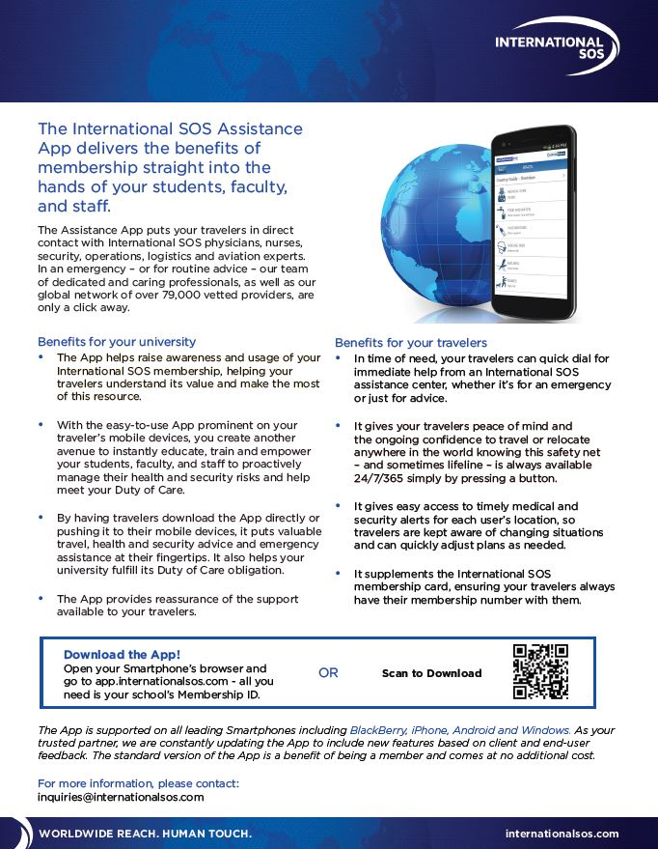
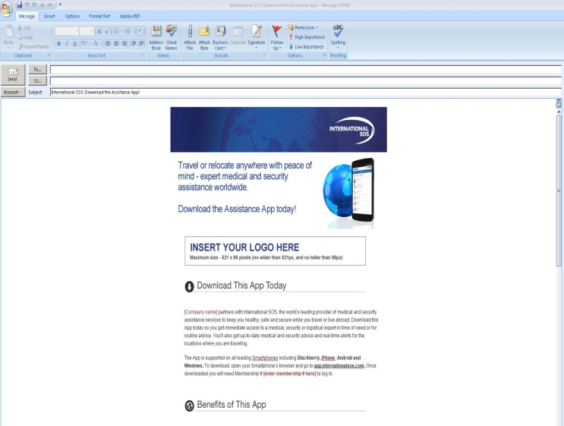
Promoting the Assistance App

Slide 19
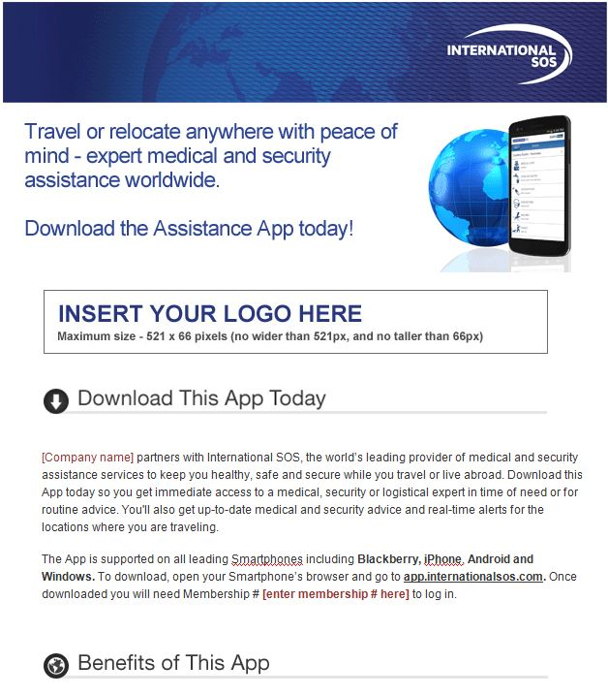
Outlook Email Template
Email campaign from a senior person to your international travelers and expatriates describing your partnership with International SOS and encouraging them to download the App.

Slide 20
Postcard-sized Handout

Slide 21
Promoting the Assistance App
Our new Pre-trip Advisories promote
the Assistance App (TravelTracker clients only)

Slide 22
Promoting the Assistance App
Add a button to download
the Assistance App to your
International SOS Portal

Slide 23
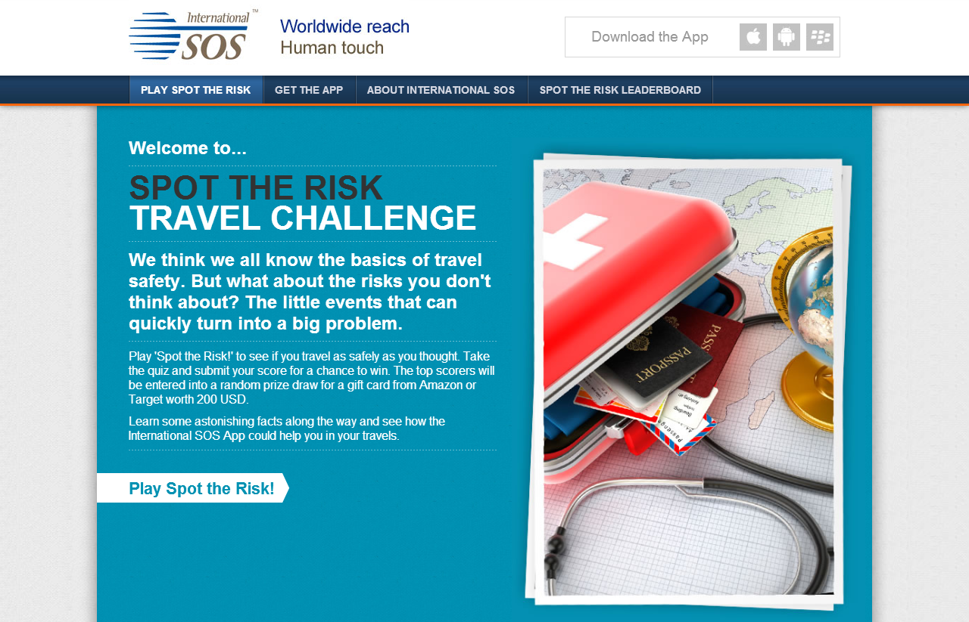
Spot the Risk Travel Challenge
Promote your International SOS program and the Assistance App by having your travelers and expatriates play the fun and educational Spot the Risk Travel Challenge.
www.spottherisk.com

Slide 24
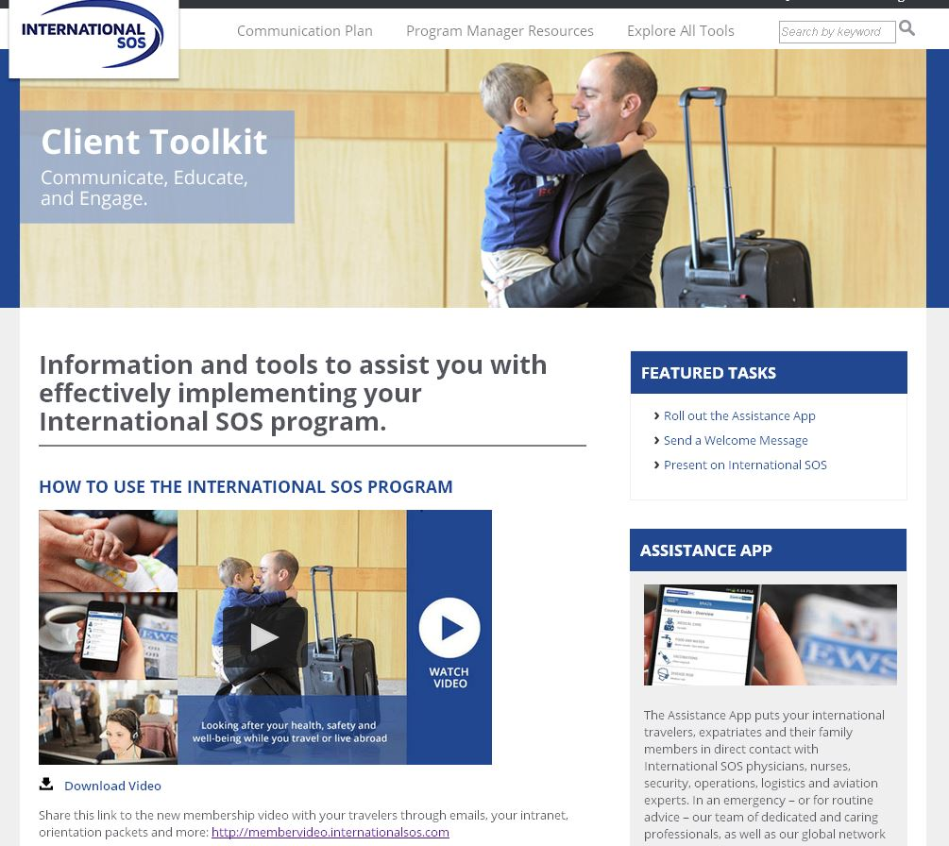
Access Assistance App Collateral
The Client Toolkit has been updated with collateral for you to promote the App amongst your international travelers and expatriates.
All of the materials mentioned in this presentation are available to download, customize, and distribute.

Slide 25
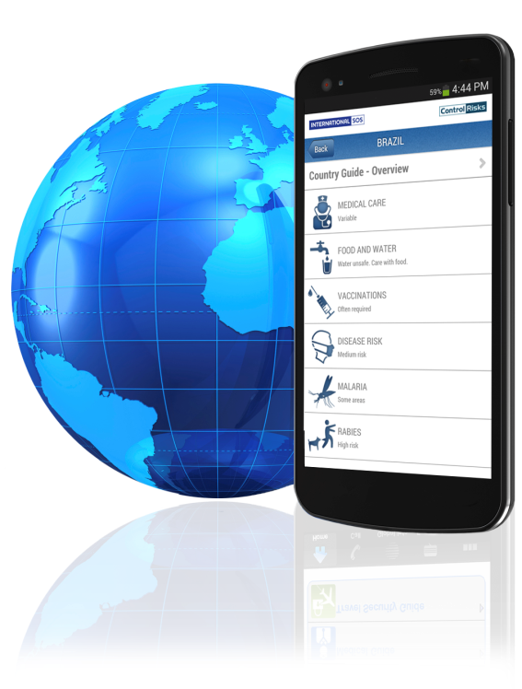
Download the Assistance App
The App is a service benefit and is available as part of your membership
Open your Smartphone’s browser and go to: app.internationalsos.com
Once downloaded, launch the App and login using your
International SOS Membership Number

